Slide 1

Next Best Location Assessment
for New ChenMed Medical Center
Weifeng Yan

Slide 2
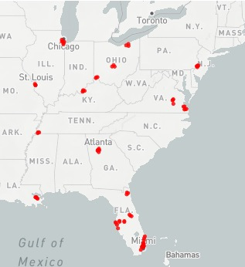
Executive Summary
Background
ChenMed is a physician-led, integrated care medical center that delivers high-quality health care for seniors who are Medicare Advantage beneficiaries
Problem
Understand the ChenMed business model and business environment
Find the next best location to open a new ChenMed center
Solution
Define a general metric to evaluate the revenue and cost of the new location in US, and choose the county which can bring most profit
Evaluate revenue by 5 dimensions
1. Elderly population dimensions
2. Facility and clinical providers
3. Residents’ health condition and disease
4. County health ranking
5. Government policy
Evaluate cost 5 dimensions
1. Rental cost
2. Staff salary
3. Tax rate
4. Customer acquisition cost
5. Competitors
Final score calculated using (revenue score – cost score); winner has the highest final score
ChenMed Health Center Location

Slide 3
Revenue Evaluation

Slide 4
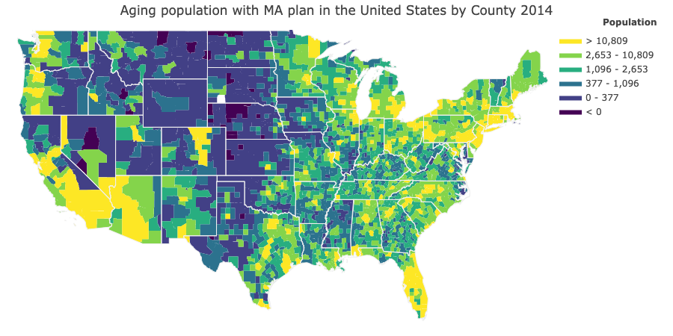



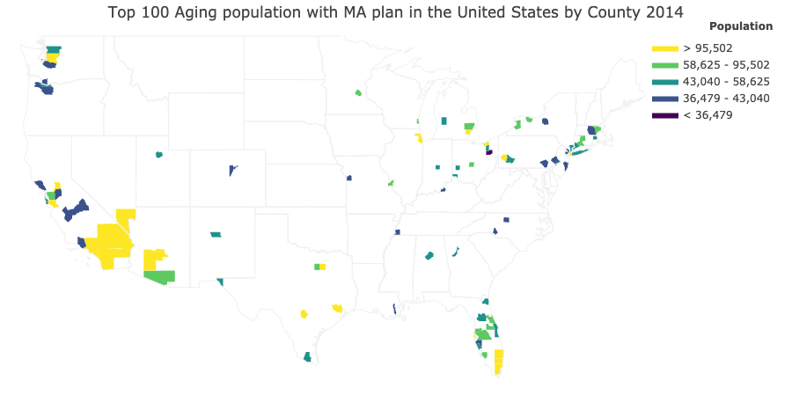
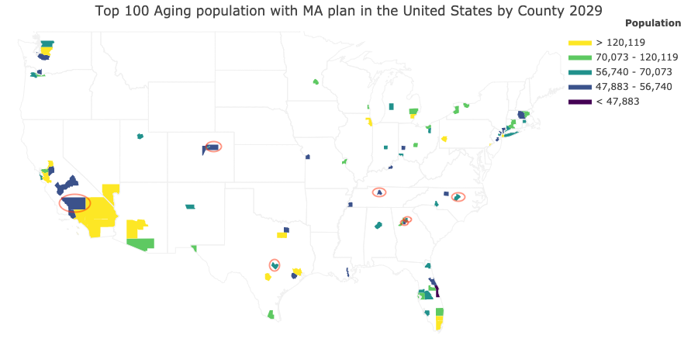
Elderly Population
Goal: Target on markets not only have large aging population right now, but also in the future
Features:
Average elderly population from 2014, 2019, 2024 and 2029
Average elderly population density
Elderly population growth rate
Elderly population growth number
Elderly population prediction model
Data:
1. County population data from US Census
2. Percentage of elderly people in each county
3. Age distribution curve in US
Modeling method:
1. Linear Regression Model
2. Age Distribution trend extrapolation
Notes:
Compare with the health care center location map in last slide,
elderly population distribution shows consistency with the locations of current healthcare company
The market can be divided into two situations according to whether there are competitors have been located. However, it is impossible to judge which location can bring the most profits based on elderly population information alone. So I added more dimensions to build the strategy.
New county entry to top 100
Travis County TX
Wake County NC
Kern County CA
DeKalb County GA
Arapahoe County CO
Davidson County TN
Collin County TX
Fort Bend County TX
Hudson County NJ

Slide 5
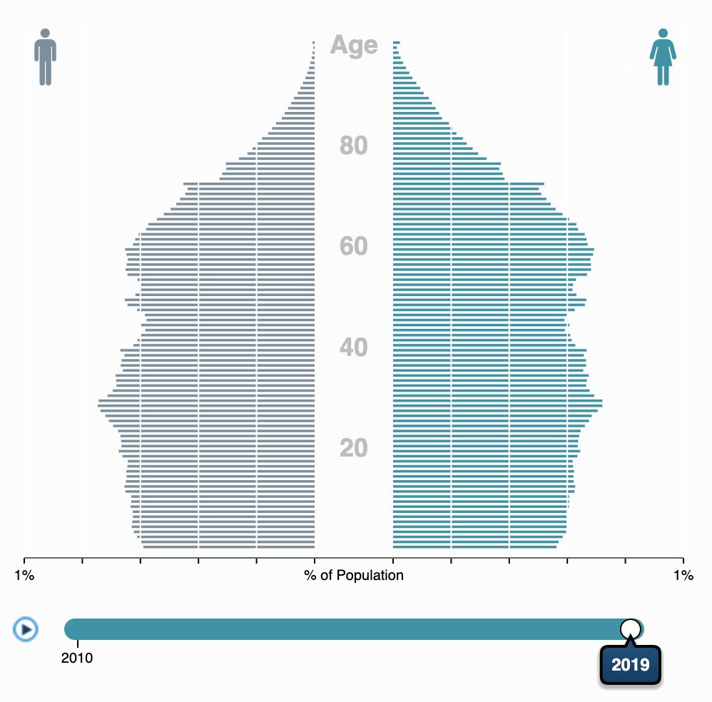
Elderly Population
US Population Distribution
Step1. Mortality Rate
Model: Linear regression model
Dataset: US population distribution dataset
For Example, we need to predict mortality rate of 65-year-old population after 5 years. So X is the distribution older than 65 in 2014, Y is the distribution older than 70 in 2019. Get the mortality rate by calculating LR model coefficient
Step2. Elderly Population
Model: Age Distribution trend extrapolation
Datasets: Elderly population in each county
For example, In 2019, people aged 55-64 in the original data became 60-69. According to the age distribution curve, it can be assumed that 40% enter 65+. By using mortality rate from step1, we can get the future elderly population.
Prediction Equation
Future elderly population =
Current elderly population * (1- Cumulative mortality rate of Current elderly population)
+ Newly elderly population * (1- Newly elderly mortality)

Slide 6
Facility and Clinical Providers
Features
Patients vs primary care physicians ratio
○ Represents the number of individuals
served by one physician in a county
○ Higher ratio, less available primary care
resources in this area
Patients vs dentists ratio
Patients vs mental health providers ratio
Opportunity for ChenMed
By increasing the treatment time for patients, the number of visits to the hospital can be reduced
Look for areas with high value for this feature, which indicates more opportunities
Notes:
If the percentage of Primary Care Physicians per capita in this area is small, companies like
ChenMed are even more needed to provide services to take care of the health of the elderly. However, due to the small number of Primary Care
Physicians, it will be more difficult for ChenMed to recruit doctors

Slide 7
Residents’ Health Condition and Disease
Features
Preventable hospitalization
Life expectancy
Age-adjusted death rate
Adults with health risk
Preventable hospitalization
Unnecessary visits to emergency room and urgent cares
For example, elderly call 911 due to inconvenience of driving to hospital
Preventable hospitalization can reflect the needs of residents for primary care
Opportunity for ChenMed
Save cost by avoiding unnecessary hospitalization
Look for areas with high value for this feature, which indicates more opportunities

Slide 8
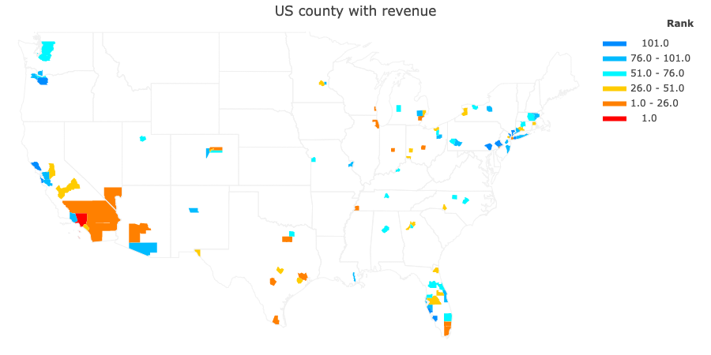
Top Revenue Rank Counties
Built the model to rank the revenue level of all counties, using all 6 dimensions
Top tier counties:
1. Los Angeles County, CA
2. Harris County, TX
3. Miami-Dade County, FL
4. Bronx County, NY
5. Cook County, IL
Model shows robustness and comprehension
Top 10 counties come from 10 states, indicating that the model can adapt to various situations comprehensively
Model not biased to any single feature
Winners for different features are all included in the top 10 list
◦ Elderly population winner: LA County
◦ Elderly density winner: Bronx County
◦ Growth rate winner: Harris County
◦ Preventable Hospitalization winner:
Miami-Dade County
Notes:
From the data, we can find that our model not only considers the elderly population (LA has the most elderly population), elderly density (Bronx County, NY), and the growth rate of the elderly population (Harris County, 0.66), whether there are competitors, and facilities and clinical provider. Moreover, the top ten locations come from ten different states, indicating that the model can adapt to various situations and consider comprehensively

Slide 9
Cost Evaluation

Slide 10
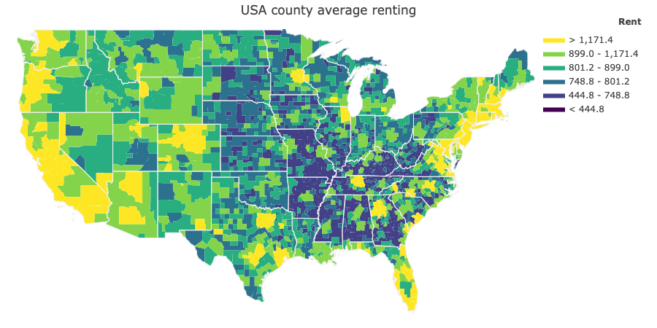
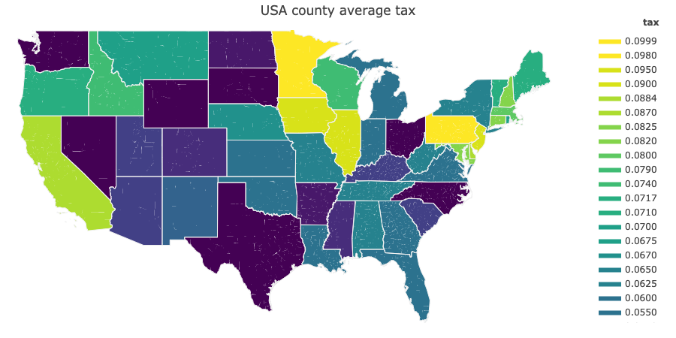
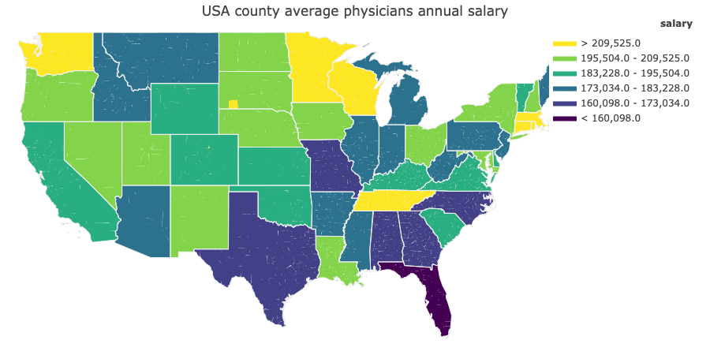
Main Factors
Rental cost
Average rent per room
Rent and population density are highly correlated
Need to balance the population density revenue and cost trade-off
Staff salary
Average annual physician salary
Physician salary and number of clinical providers are negatively correlated
Need to balance the trade-off between market opportunity (more when less clinical providers) and staff salary (higher when less clinical providers)
Tax rate
Corporate tax in each state
Customer acquisition cost
Advertisement
Medical instruments
Medication dispensary

Slide 11
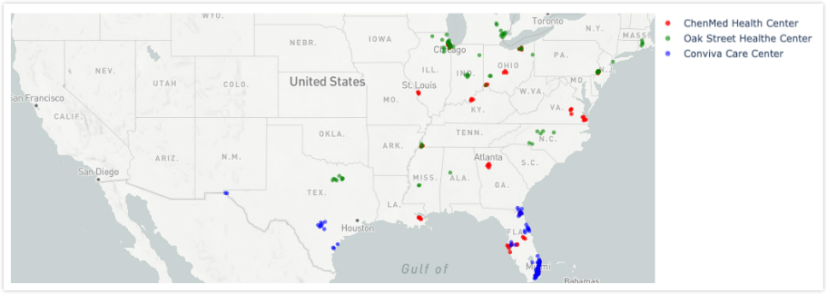
Competitors
Revenue for health care centers is driven by aging population density
Market competition in first-tier cities is fierce, such as PA, FL, Chicago
Market in second-tier cities is broader
ChenMed and competitors mainly locate in the central and eastern regions
Establish next location in area where no competitors have settled in will largely save the cost of customer acquisition
Notes:
I designed and conducted the python web scraping pipeline by using the Beautiful Soup Python package to extract Oak street health and Conviva care center‘s office location.
And I wrote a python code to translate address into Latitude and Longitude, so that I can mark those offices in the map and think in a big picture

Slide 12
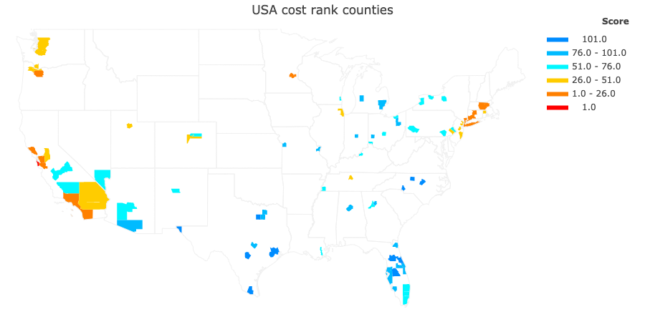
Top cost rank counties
Built the model to rank the cost level of all counties, using all 4 dimensions
Top tier counties:
1. San Mateo, CA
2. San Francisco, CA
3. Santa Clara, CA
4. Middlesex, MA
5. Honolulu, HI
High cost will reduce the overall profit For example, although in the revenue analysis, LA county ranks first, it also ranks very high in the cost ranking.
Top 10 counties all come from large metropolitan areas

Slide 13
Next Location Evaluation

Slide 14
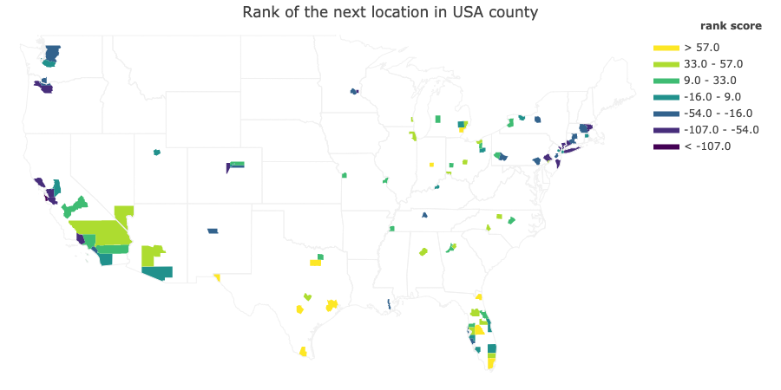
Next Location
Find the county with high revenue ranking and low cost ranking
Rank score =
revenue rank – cost rank
Top tier counties:
Harris County, Texas
Tarrant County, Texas
Wayne County, Michigan
Marion County, Indiana
Philadelphia County, PA
Model shows robustness and comprehension from revenue and cost
For example, in the revenue analysis, Harris county ranks second, it ranks 108th in the cost ranking. So that it can get the most profit

Slide 15
Next Location
Through the above analysis, I chose two best locations.
One is to develop a new market, Harris County, Texas, which has a huge aging population base, and aging population is growing rapidly. Doctors’ salaries are low, and there is no corporate tax. There will be huge profits to establish a new healthcare center here.
The other is to jointly develop the existing market with Oak Street Health. The elderly population density of Philadelphia County is relatively high, and the aging population agrees to grow rapidly.
Harris County, Texas
Revenue rank: 2
No competitors in this place
Large base of elderly population, 204338
High growth rate of the elderly population, 0.661928
High Patients vs primary care physicians ratio, 1697: 1
High Preventable Hospitalization, 5042
Residents’ life expectancy, 79.6
Cost rank: 110
Low corporate tax, 0
Low average annual physician salary, 172216.0
Low average rent per room, 1309.2
Potential Cost
Negative local government policy
Unknown competitor
Philadelphia County, PA
Revenue rank: 27
Large base of elderly population, 92501
High elderly population density, 689.793225
High growth rate of the elderly population, 0.426114
High Patients vs primary care physicians ratio, 1449: 1
High Preventable Hospitalization, 5894
Residents’ life expectancy, 76.1
Cost rank: 48
High corporate tax, 0.0999
Medium average annual physician salary, 180399
Low average rent per room, 1312.6
Oak Street health has opened 9 health centers and ChenMed has opened 5 health centers
Potential cost
Analyze the market coverage of competitors

